Slide 1
Continuously delivering
James Cowie
Senior Magento Engineer @ Magento
Magento 2016 Master

Slide 2
Continuous Integration
Notes:
Continuous Integration was first named and proposed by Grady Booch in his 1991 method, ( The booch method ). it was adopted as part of extreme programming (XP), which did advocate integrating more than once per day, perhaps as many as tens of times per day.Acording to ThoughtWorks Continuous Integration is a practice that says we should integrate our code into a shared repo daily. Each check in is then verified by a automated build allowing team to detect problems earlier.So in theory I should not have to worry about syntax errors, Failed tests and it will be my early warning system.

Slide 3
Benefits
Say goodbye to long and tense integrations
Increase visibility which enables greater communication
Catch issues fast and nip them in the bud
Proceed in the confidence you’re building on a solid foundation
Reduce integration problems allowing delivery of software more rapidly
Notes:
Long and tense intgrations, So instead of having this phase at the end of a piece of work trying to integratie it back to develop I will have been "practicing this all the way through the feature" so its just another step to merge it.Visibility, We have a dashboard setup in the offices but the visibility of passing and failling builds could spark converssationsWhen integrating features a smaller issues is always going to be easier to fix than a weeks worth of work so testing this integration can help avoid such mess.Catch issues faster, Because each push starts a new inspection of code, tests we can get faster feedback on issues and the state of the build.We long longer have to solve as many integration problems as before. So we can spend more time writing software than solving integration problems.

Slide 4
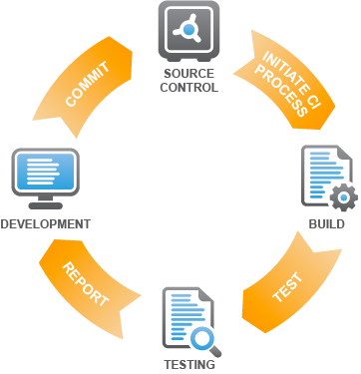
Notes:
From a development perspective there is not difference, depending on what tool you want to do the integrations. All of this can be ran offline and added as git hooks and bash files.In a vanilla world, We start work on a new feature: - Commit some work - git detects this change and knows to run a build - This will run Mess Detector Copy Paste Complexity etc. Tests - Concoluding in a report file either pass or fail.Each tool generates its own output and different services that can be used will generate different reports and additional features. Scrutinizer will offer a code score.

Slide 5
Continuous Delivery / Deployment
Notes:
Continuous delivery is a software engineering approach in which teams produce software in short cycles, ensuring that the software can be reliably released at any time.[1] It aims at building, testing, and releasing software faster and more frequently. The approach helps reduce the cost, time, and risk of delivering changes by allowing for more incremental updates to applications in production. A straightforward and repeatable deployment process is important for continuous delivery.

Slide 6
short cycles
Sprints
reliably released
Working software over comprehensive documentation
faster .. Frequently
Responding to change over following a plan
Notes:
While reading through the definition I found something really interesting. And that was what the Agil manifesto says.Lets take Short cycles this sounds a lot like what we did in Agile with sprints,Reliably released made me think about the Agile manifesto Working software over comprehensive documentation Faster and Frequently made me think 'Responding to change over following a plan'.So really by doing agile well we should be part way there to getting CD working ?

Slide 7
Benefits
Accelerated Time to Market
Building the Right Product
Improved Productivity and Efficiency
Reliable Releases
Improved Product Quality
Improved Customer Satisfaction
Notes:
Accelerated time to market: CD lets an organization deliver the business value inherent in new software releases to customers more quickly. This capability helps the company stay a step ahead of the competition.Building the right product: Frequent releases let the application development teams obtain user feedback more quickly. This lets them work on only the useful features. If they find that a feature isn’t useful, they spend no further effort on it. This helps them build the right product.Improved productivity and efficiency: Significant time savings for developers, testers, operations engineers, etc. through automation.Improved releases: The risks associated with a release have significantly decreased, and the release process has become more reliable. With CD, the deployment process and scripts are tested repeatedly before deployment to production. So, most errors in the deployment process and scripts have already been discovered. With more frequent releases, the number of code changes in each release decreases. This makes finding and fixing any problems that do occur easier, reducing the time in which they have an impact.Improved product quality: The number of open bugs and production incidents has decreased significantly.Improved customer satisfaction: A higher level of customer satisfaction is achieved.

Slide 8
Continuous Delivery
Acceptance
Tests
Deploy to
production
Code done
Unit Tests
Integrate
Manual
Continuous Deployment
Acceptance
Tests
Deploy to
production
Code done
Unit Tests
Integrate
Auto
Notes:
Lets take a look at what is different with the two processes then.They both should follow the same automated process progressing from: Code done, through unit tests, integration acceptance tests and where it differs is that deployment to production requires a manual step.If we are doing continuous deployment we automate every step all the way up to deploying to live so in theory there should be no human touch from when the developer commits the code to the code hitting live.

Slide 9
Development process so far.
Notes:
We now know about the theory and each of the benefits associated with CI, CD and it all sounds great in theory. before we move on is anyone here actually using CI in there workflow ? Ok what about CD is anyone using this ?Ok lets take a look at how I worked with projects both Magento 1 and Magento 2 before I embarked on this change

Slide 10
Pipeline Servers
Notes:
Being able to see the the site while in development is key so we always start with our pipeline servers.

Slide 11

QA
Notes:
By default we start with QA. Our QA server is where developers can push code to for internal QA to check. Nothing passes this server without QA approval.

Slide 12
QA
UAT
Notes:
The client gets involved at UAT. This is where the client can perform there testing of features.

Slide 13
QA
UAT
Live
Notes:
Concluding in live where where real customers test our work :)

Slide 14

QA
UAT
Live
Notes:
Lets take a look at how the flow of features travels from developer to live. We have finished a few features at the same time and we deploy our features to QA.

Slide 15
RELEASE
QA
UAT
Live
Notes:
Then at a key point in the project we decide that the client needs to start approving this set of features so we schedule a release to UAT.

Slide 16
RELEASE
RELEASE
QA
UAT
Live
Notes:
The client tests and approves all of the features and we deploy these to live. Clients happy and so are we.

Slide 17

RELEASE
RELEASE
QA
UAT
Live
Notes:
One of the reasons I started to look at our deployment and release process was because it felt like getting features to live took a lot of time and effort. There felt like a gap of time between starting the feature and getting all that work approved and passed over to production.

Slide 18
RELEASE
RELEASE
QA
UAT
Live
Notes:
Then time came into my mind again, The client is busy and sometimes it was a different stakeholder that was responsible for each feature. Getting there time to approve and validate the work felt like a duration of time.

Slide 19
What is time ?
Notes:
So it got me thinking about time and what time means in my project. How do we see the difference between something takeing a long time to something being done on time. And why is time so important when looking at continuous delivery.

Slide 20
https://en.wikipedia.org/wiki/Scrum_(software_development)
Notes:
Time for me on my projects is defined in our process. Agile. Sprints are measured in Time, We do release updates during that time but mainly we focus on delivering X amount of features in Y number of sprints so our focus is on getting that sprint done so we can release that work. Now there is another argument all together on if we need to look at sprints being shorter. In waterfall we had Years, Then agile got us to think shorter but the 2 weeks sprint has got people questioning if its too long still for modern software.

Slide 21
RELEASE
RELEASE
QA
UAT
Live
2 Weeks
?
Notes:
For our projects we have a 2 week sprint where during that time features are being worked on, Features are going from QA into UAT so we could have a fixed 2 weeks where we wont in theory be deploying to live because all the work is what we planned to get done in 2 weeks.There is also the time taken for the customer or stake holders to validate the work and ensure it passes there expectations.

Slide 22
How does this look in source control
Notes:
What I found really interesting was when we look at how this is done in our source control process.

Slide 23

Release Candidate
Develop
Master
QA
UAT
Live
Notes:
As a team we have finished X number of features. They all passed peer review and our automated testing process. So the code is in develop branch. When we want to show the client or stake holders we branch of develop and create a "release branch" this gets deployed to UAT and the client or stake holders tests and approves. Once we are all happy we merge the release branch into master and deploy that to the live servers.

Slide 24
Release Candidate
Develop
Master
QA
UAT
Live
Notes:
So in each phase of our release process each of the units of work are contained in that branch. E.g. we are not forming a new branch and merging feature branches in and keeping the feature branch around to then create a master branch.

Slide 25

Notes:
Where this really breaks down is if the client wants one of those features removing or if they decide that not all the features can go live at the same time.

Slide 26
Release Candidate
Develop
Master
Notes:
Because all of the work is contained within the same branch it adds complexity to our release process as we need to look at taking parts out.

Slide 27

Notes:
I couldnt find a nice picture to show Rebase or revert merge. But it gets us into the solution where we start cherry picking certain features out of releases. Its not simple as sometimes work has dependencies and all this can get lost in translation with the customer on what went live etc.

Slide 28
Increased Time to deploy
Notes:
This in turn has a cost of time to deploy. Time to get the features live is increased from what we think should be a suitable time.

Slide 29
What did I want improved ?
Notes:
So give or take a few steps that was my workflow that I have seen and used over X number of years, And now I had the opportunity to look back and analyse what we were doing well and not so I actually had time to think about what I wanted to improve and why.

Slide 30
Feedback
Feedback
Feedback
Notes:
Time featured big again in this one. I wanted the time for getting feedback to be improved. Feedback I wanted faster from many different sources for many different reasons.

Slide 31
=
Time
Feedback
given
Time
started
Feedback
time
Notes:
I even invented what I call "Feedback Time" If you take the time stamp from when you deployed the feature into Peer review and subtract the final time you got Feedback from a customer that gives you a working "Feedback time" that you can asses time with. Its also worth looking at this across the board so time from First QA contact etc to help identify possible bottlekneck that may appear.

Slide 32
Feedback Time
Cognitive load & Human retention
Project flow
Validation
Notes:
So I want feedback time to be improved, But why ? Well cognitive load, I can only keep so much information in my head, Once that RAM chip gets flushed I need to go through a small amount of re learning on a task to build up the nero network that allows be to remember what I was working on. Jumping between tasks is always hard and returning to a piece of work 1 2 + weeks ahead does increase the time to learn the feature again.Project flow, Ensuring we have a smooth flow of work from Developer to End user is important so that we avoid big buildups of work causing a bottleneck and then slowing down the entire process. a massive push of code from developers can overload the QA and causes the customer and end user having to wait longer for there jobs to start.Validation. I wanted faster validation that I understood the problem both from QA and from the Stake holder. Being able to show them early prootypes and getting feedback on non complete work was how I wanted to work on larger more complex tasks so that it became less of a suprise on delivery day.

Slide 33



Feedback from who ?
QA Team
Real User
Team Lead
Stakeholder
Notes:
There are many different forms of feedback and each one has a place in the flow,QA team can validate that the feature works and that edges are found and tested. They are also trained to break things.Our Team Lead or project stakeholder can review code and features to confirm they they pass our internal testing.A key steak holder within the business or project we are working on can confirm that the feature is indeed adding the value that the business wants and is useable for there requirements.And end users can validate and provide feedback, Either by reporting bugs or with looking at analytical data. How many continued to use the feature, How many people used the feature. Here there are many different ways of getting and analysing the feedback.

Slide 34
Why
Internal Feedback
External Feedback
Notes:
I started to look more into feedback and what each consisted of and I started to find really interesting articles around Internal Software vs External software. And that they are not mutaly exclusive. There are different forces pushing and pulling on each type. External generally focusing on the Useability of a feature and Internal looking more at the internals and architecture of a feature. And this led me to see if the same was possible in defining feedback. My goal being that if I understood the types of feedback I wanted then I should know who directly provides that feedback.

Slide 35
Why
Code analysis
Acceptance Criteria
Internal Feedback
Exploratory Testing
Regression Testing
Notes:
I see internal feedback being provided by all internal parties ( QA team, Developers the people directly involved in the low level creation of the code that makes up the feature )So Internal feedback Does include some UI but is mainly concentrated around the code and how the code works in isolation. Does it work with the system but also does it work it being just the feature.

Slide 36
Why
How does it look?
Are people using this feature?
External Feedback
How are people using this feature?
Is this feature solving a problem?
Notes:
External feedback I decided become End users, Stake holder in the business or for the project. Someone who this feature irectly solves a need for or they care a lot about the feature or its direct impact.Wheras if you look at external feedback. Then the questions I started to as about the feature were about its value, its form and function. Is it being used, What does it look like, How can I get to this new feature.

Slide 37
QA
UAT
2 weeks
Notes:
Once I finished looking at the feedback types I started to look at how long it would take for me to directly get that feedback on my desk, Because we use 2 week sprints there is a minimum of 2 weeks in our current workflow where a feature could be approved by a stake holder.

Slide 38
UAT
LIVE
2 weeks
Notes:
In theory it could also be up to 2 weeks before the sprint features that the client has approved as deploy ready could hit the hands of end users.

Slide 39
What options did I see?
Notes:
Granted some of the above with times is excessive. If a client wants work live, work goes live but its not a normal working day process we tend to work how we feel comfortable humans are mamals of habit so we follow our agile process to release to UAT each sprint and then big bang relese to live.So I wanted to see what else was out there, I see and hear all the time that people are depoying to live daily hourly and many times a day yet still expanding and gaining traction. In this world of every changing digitial horizons waiting hours is considered bad form and the next big thing can come and take over so being agile and responding to needs is now more important than ever.

Slide 40
Feature Branches
Notes:
Feature branches appeared to be one of the options that I could use in order to achieve continuous delivery and deployment. For a large chunk of this method we had already been using this in our daily workflows thanks to the Git feature branch workflow.

Slide 41
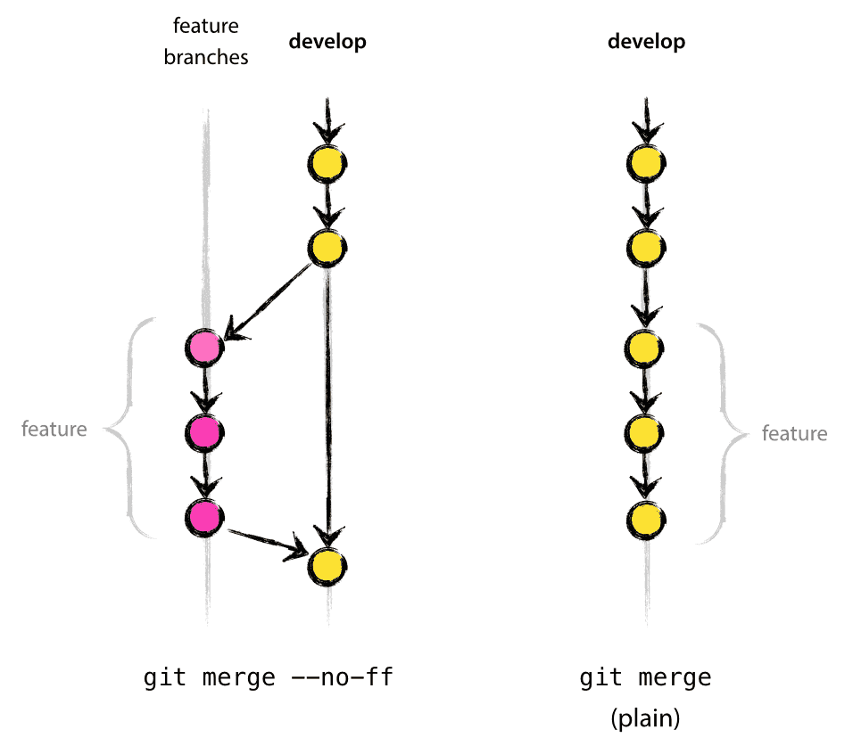
Notes:
A recap of how feature branches work can be seen in this diagram. We have a develop branch that we consider deployable at any time, When we start a new feature we branch from develop into our feature named branch. Continue to work on this branch remembering to integrate develop into our branch on a regular basis. Then once we finish our feature we merge it back into develop.

Slide 42
The rules of feature branching
Always deployable
Feature complete
Tests
Notes:
Feature branching has rules, and this is where continous deployment's version of feature branching is different to what we may have already been doing.We expect that mainline is always deployable to production all of the time. And for it to be deployable we expect that all features being merged into the mainline branch are "feature complete"Now we know that it is stable and could be deployed because we have been integrating our feature branches many times per day, We have been running our unit and integration tests and everything is passing.

Slide 43
feature.project.pipeline.com
Mainline
Live
Release
V1
feature2.project.pipeline.com
QA.project.pipeline.com
Notes:
Using feature branching in a project the process of source control looked like this.We have a single mainline branch that we consider to be stable and deployable at all times. When we want to work on a new feature we branch off master and create our feature branch. Many times per day we integrate master back into our feature branch.However when the feature is considered complete, we do not merge and deploy straight away. As we have a instance spawned by docker for the integrated feature branches stand alone QA can be performed.We then get ready for a "release" where we take each of the feature branches that have been approved to go live and form a "Release branch" this gets deployed into UAT and regression testing takes place now all of the stories are integrated together. We then merge this release branch back to master finally deleting the feature branches.

Slide 44
Disadvantages
Advantages
Manual process
Feature branch rot
No reverse merging
Clear to see features
Notes:
This aproach has its advantages but it also its disadvantages. To start with unless you are using one of the fully featured tools such as Jira and Bamboo the process becomes very manual. Creating the release branch and merging becomes labour intense.Also depending on how long the release is and what process of formalisation for sign off there is the feature branches could suffer "Feature branch rot" where they sit there, The rot comes from the fact that they are not being worked on at that moment so no longer do the get master integrated back in this causes a large release with possible conflicts.But with the disadvantages there are also advantages. We have a stable and deployable master branch because we are only ever merging in work that can go live, Because we have to go throgh the phase of creating the release we can see eaisly what features are included.

Slide 45


Slide 46
What are feature toggles ?
Disable / Enable
Logical switch

Slide 47
Feature toggle disabled
Mainline
Live
Feature toggle disabled

Slide 48
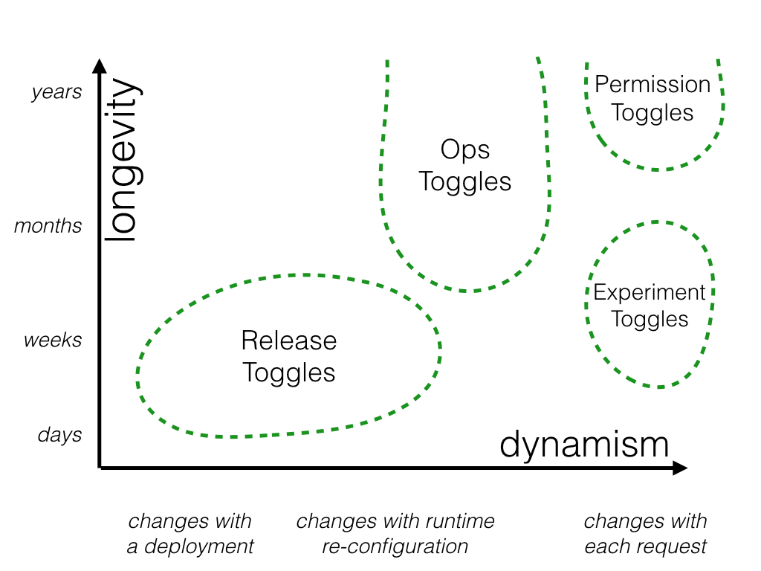

Slide 49
//$MyNewFeature->run();
Super simple toggle ( git commit –m ”Disable/Enable feature X”

Slide 50
<?php … if ($someFeature)->isEnabled() { ….. } …

Slide 51
Packages

Slide 52
Meet “Qandidate\Toggle”

Slide 53
<?php // Create the ToggleManager $manager = new ToggleManager(new InMemoryCollection()); // A toggle that will be active when the user id is less than 42 $operator = new LessThan(42); $condition = new OperatorCondition('user_id', $operator); $toggle = new Toggle('toggling', array($condition)); // Add the toggle to the manager $manager->add($toggle); // Create and check a new context for a user with id 42 $context = new Context(); $context->set('user_id', 42); var_dump($manager->active('toggling', $context)); // false

Slide 54
<?php // Create the ToggleManager $manager = new ToggleManager(new InMemoryCollection()); // A toggle that will be active when the user id is less than 42 $operator = new LessThan(42); $condition = new OperatorCondition('user_id', $operator); $toggle = new Toggle('toggling', array($condition)); // Add the toggle to the manager $manager->add($toggle); // Create and check a new context for a user with id 42 $context = new Context(); $context->set('user_id', 42); var_dump($manager->active('toggling', $context)); // false

Slide 55
<?php // Create the ToggleManager $manager = new ToggleManager(new InMemoryCollection()); // A toggle that will be active when the user id is less than 42 $operator = new LessThan(42); $condition = new OperatorCondition('user_id', $operator); $toggle = new Toggle('toggling', array($condition)); // Add the toggle to the manager $manager->add($toggle); // Create and check a new context for a user with id 42 $context = new Context(); $context->set('user_id', 42); var_dump($manager->active('toggling', $context)); // false

Slide 56
<?php // Create the ToggleManager $manager = new ToggleManager(new InMemoryCollection()); // A toggle that will be active when the user id is less than 42 $operator = new LessThan(42); $condition = new OperatorCondition('user_id', $operator); $toggle = new Toggle('toggling', array($condition)); // Add the toggle to the manager $manager->add($toggle); // Create and check a new context for a user with id 42 $context = new Context(); $context->set('user_id', 42); var_dump($manager->active('toggling', $context)); // false

Slide 57
Adding toggles ?

Slide 58
$ curl -XPUT 127.0.0.1:8000/toggles/search_beta -d '{
"name" : "search_beta",
"status" : "conditionally-active",
"conditions" : [
{
"name" : "operator-condition",
"key" : "user_id",
"operator" : {
"name" : "in-set",
"values" : [42, 1337]
}
}
]
}'

Slide 59
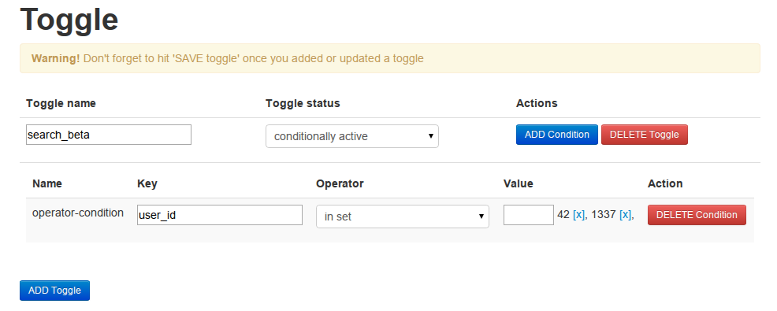
https://github.com/qandidate-labs/qandidate-toggle-ui

Slide 60
Services

Slide 61

Feature toggle dashboard
Many rules for toggles
Statistics

Slide 62
Disadvantages
Technical Debt
Extra code and configuration
JS / CSS ?

Slide 63
Benefits
Deploy all the things
A-B Testing
Easy revert
Client engagement in deploy

Slide 64
End to end workflow

Slide 65

PHPMD
PHPLint
PHPCPD
PHPUnit

Slide 66

Peer review

Slide 67

Build release candidate

Slide 68

Static code analysis

Slide 69

Deploy to first pipeline

Slide 70

Testing

Slide 71
Go live

Slide 72
My proposed workflow

Slide 73
Code
Plan
Build
Deploy
Test

Slide 74
Our solution
BDD
User Stories
Business Value
Example Workshops
Feature Toggles
Feature Branches
TDD

Slide 75
BDD ( Behaviour Driven Development )
Starts the conversation
Value
Intent
The Why!

Slide 76
User Stories
Becomes Acceptance Criteria
Thought about scenarios
Validation of the work

Slide 77
Business Value
What value does this story have.
What does it impact
How measurable is the story

Slide 78
Example Workshop
Final chance to “pull a story”
Understanding
Readiness for development

Slide 79
Feature Toggles

Slide 80
Feature Branches
feature/PROJ-Number
Delete once passed review
Short lived

Slide 81
TDD ( Test Driven Development )
No feature without
Behat
PHPSpec
* Some PHPUnit for M2 *

Slide 82
How?

Slide 83
Github + Git

Slide 84
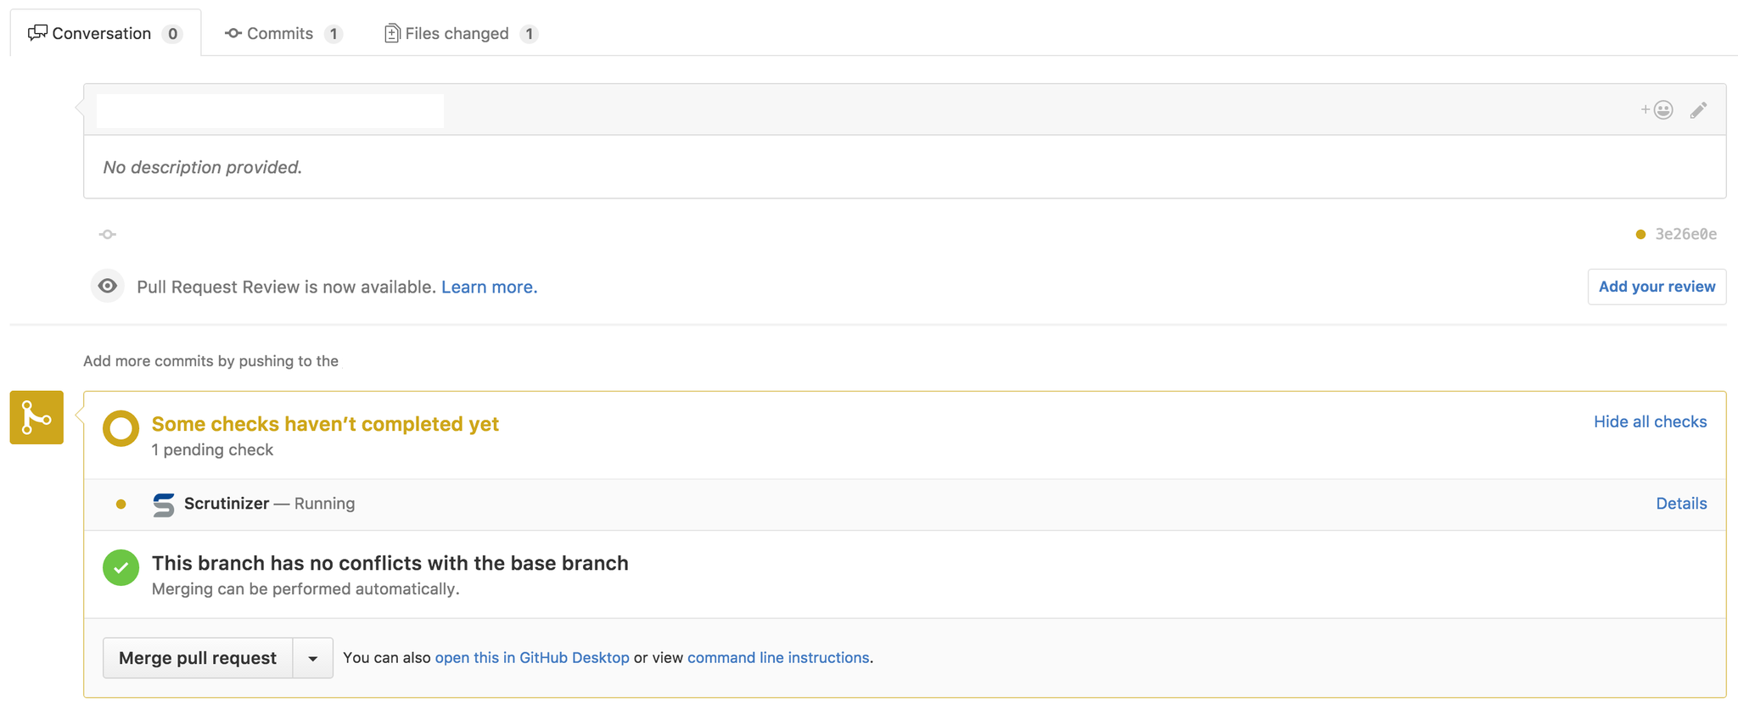

Slide 85
Magento 2
Sysconfig for toggle
Helper module for validation

Slide 86
Scrutinizer
Static Analysis
Running of tests
Deployment mechanism

Slide 88
Deploying ?

Slide 89



Slide 90
deployment: - branch: develop commands: - { command: '(cap qa deploy)', idle_timeout: 600 } - branch: master commands: - sudo apt-get install -y sshpass - { command: '(cap uat deploy)', idle_timeout: 600 } - branch: release/* commands: - sudo apt-get install -y sshpass - { command: '(cap prod deploy)', idle_timeout: 600 }

Slide 91
State

Slide 92
Every change needs a script
Migrations
Magento setup scripts.

Slide 93
Every environments needs a config

Slide 94
Environment variables
Environment config files

Slide 96
https://github.com/davidalger/capistrano-magento2

Slide 97
gem install capistrano-magento2
mkdir -p tools/cap

Slide 98
# Load DSL and set up stages
require 'capistrano/setup'
# Load Magento deployment tasks
require 'capistrano/magento2/deploy'
# Load custom tasks from `lib/capistrano/tasks` if you have any defined Dir.glob('lib/capistrano/tasks/*.rake').each { |r| import r }

Slide 99
cap staging deploy

Slide 100
Other services and platforms

Slide 101


Many More..

Slide 102
Further reading

Slide 103


Slide 104
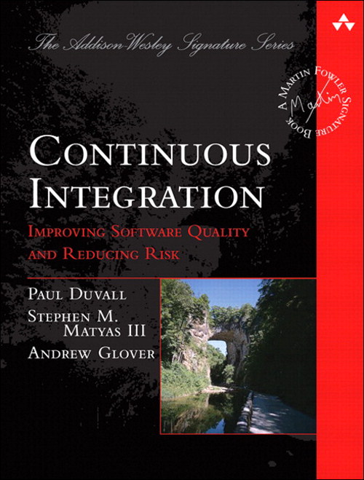

Slide 105
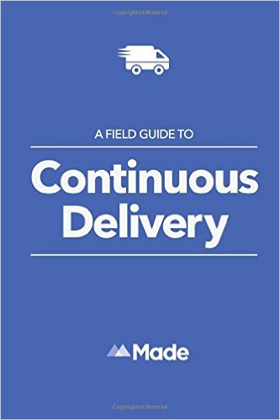

Slide 106


Slide 107
Q and A
@jcowie
Jamescowie (github)

